Slide 1
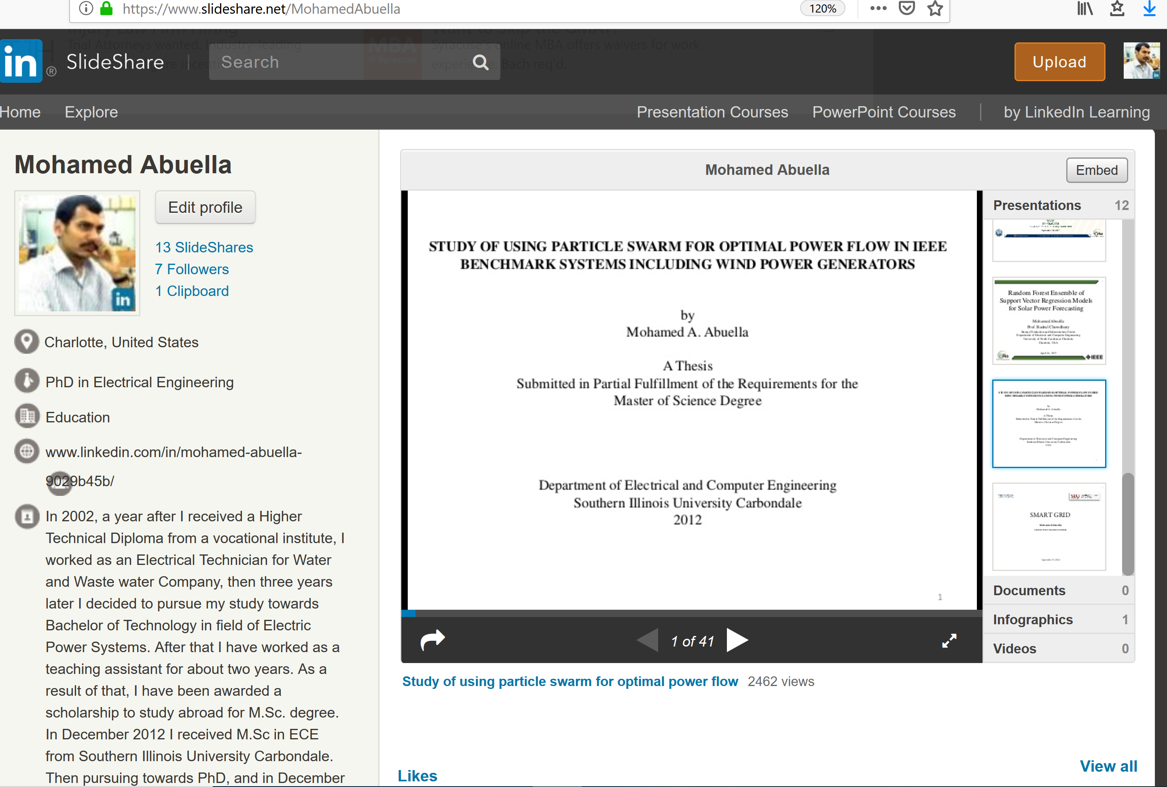
https://www.slideshare.net/MohamedAbuella

